Slide 1
IT Infrastructure Architecture
Infrastructure Building Blocks
and Concepts
Infrastructure lifecycle
(chapter 15 - 16)

Slide 2
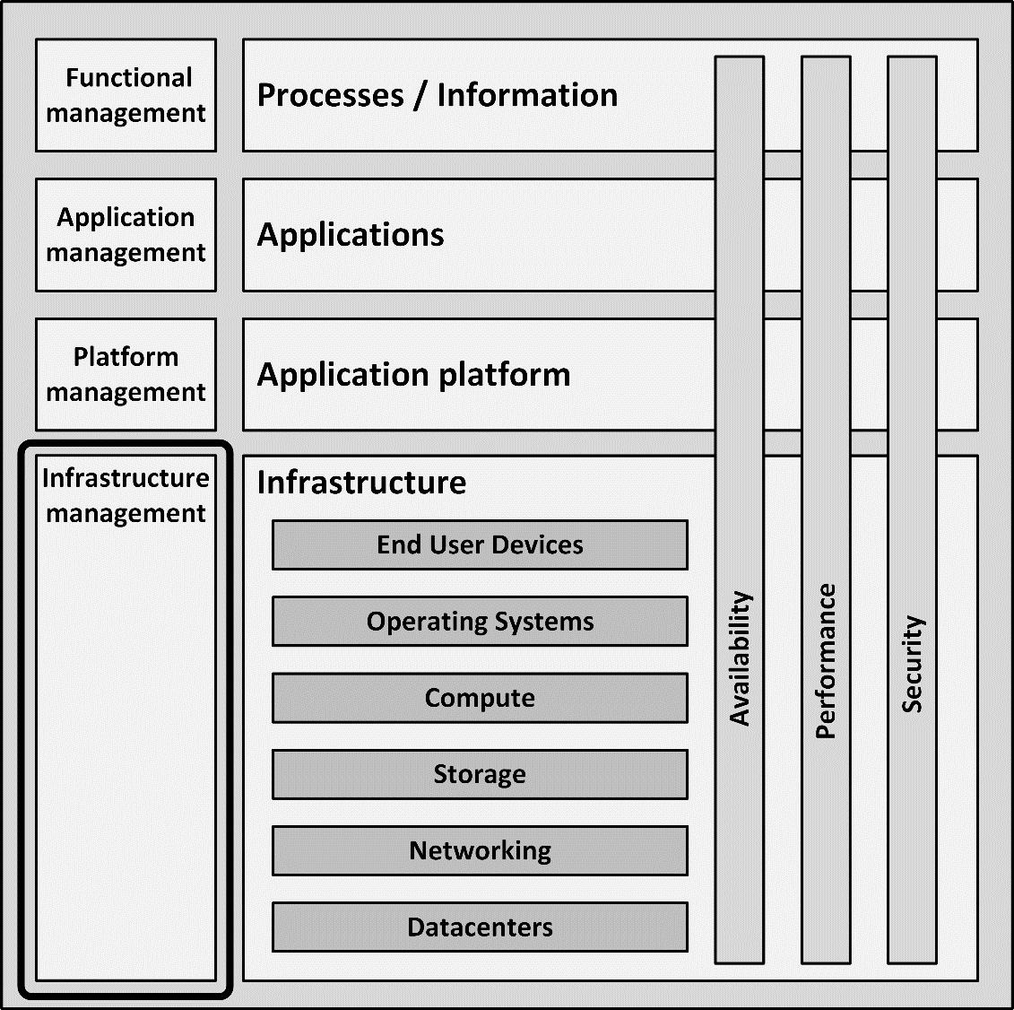
Introduction
The infrastructure lifecycle encompasses the following steps:
Purchasing infrastructure and services
Build-up, testing and go-live
Maintaining the infrastructure
Deploying applications
Decommissioning the infrastructure

Slide 3
Purchasing infrastructure and services

Slide 4
Purchasing infrastructure and services
Most large-scale IT projects require procurement of hardware, software, or services
The purchase process entails:
Determining what is needed
Getting an offer
Ordering
Delivery
Warranty
Renewal

Slide 5
Determine what is needed
Before any purchase can be made, it must be crystal clear what is actually needed
A Bill of Materials (BoM) is made that includes part numbers of all items
If allowed by the purchasing rules, work with suppliers to get the BoM
Also a Statement of Work (SoW) is made
A SoW describes what the supplier will do, apart from delivering the goods
It must be clear from the start who does what
The supplier can have specific requirements, like:
Is a loading dock available to deliver goods to the datacentre?
Is the elevator large enough to lift the equipment to the final destination?

Slide 6
Getting an offer
In a large organization, the lead time for the internal procurement process can be several weeks, or even longer
Find a supplier
Handle contract issues and/or to get signatures from management to formally place the order
Procurement will try to get discounts
It typically takes four to eight weeks for the supplier to deliver the goods

Slide 7
Choice of suppliers
Most organizations use preferred suppliers for standard purchases
Having a small number of preferred suppliers makes the purchase process easier
Contracts are already in place
Discounts can be negotiated because of large volume purchases
Organizations often choose for a predefined purchase policy for their software stack
When possible all software is either purchased from preferred suppliers, or built based on technology from preferred suppliers

Slide 8
Choice of suppliers
The alternative is using a best of breed policy
Each component is chosen based on the best quality or the most comprehensive feature set
Combination also possible:
A standard software stack for commodity components
Best of breed products for highly specific tasks, that are close to the core business processes

Slide 9
Choice of suppliers
With hardware, predefined choices are typically made as well
For instance, a policy could be to buy all network equipment from Cisco and all servers from HP
Easier management of support contracts
When a hardware component fails, one telephone number to the supplier’s support desk is all it takes to start the repair process
Limit the knowledge needed in the organization to manage components

Slide 10
Choice of suppliers
Having preferred suppliers can lead to a vendor lock-in
After some time, for practical reasons, it becomes unfeasible to change suppliers
The resulting lack of competition can lead to
A higher price level in the long run
A decrease in service levels

Slide 11
Bidding and tendering
Getting an offer may involve a formal bidding process, also known as tendering
In general, a bidding process comprises the following steps:
RFI – Request for Information
A large group of suppliers is asked to inform the purchase department if they are capable of providing the required goods or service

Slide 12
Bidding and tendering
Short list
Based on the RFI responses, the purchase department creates a short list of suppliers
Which are most likely to be able to deliver the goods for a good price and with good service?
RFP – Request for Proposal
Suppliers in the short list are requested to make a proposal for the delivery
Questions and clarification
Planned between the publication of the RFP and the supplier’s responses
Suppliers are given the opportunity to ask questions about the RFP (in writing)

Slide 13
Bidding and tendering
Offer
Suppliers provide the answers to the RFP
Includes an initial offer
Terms and conditions negotiations
The purchase department starts negotiations with the suppliers that provided the best response to the RFP
BAFO - Best and final offer
Preferred suppliers make a final price and SoW
This is their last chance to change the offer
Award
Based on the BAFO, the purchase department awards the supplier with the deal

Slide 14
Ordering and delivery
Ordering
Typically done by the purchasing department
Because the delivery time is often weeks after the purchase order is placed, it makes sense to start ordering the goods as early as possible
Delivery
Beware that the person that physically receives the goods, is not always the one formally accepting the delivery
Before signing for delivery, check the boxes for any damage and check for completeness of the delivery
Warranty period
During the warranty period, defects will be fixed without additional cost

Slide 15
Renewal
When purchased goods are used for some time, they might need renewal
Hardware is often used for five years before it is replaced
Software typically has makor releases every few years
Service contracts are also often agreed upon for a fixed number of years
Often a renewal of the hardware, software licenses, or service contracts leads to a new purchase process
Systems management should have a Life Cycle Management (LCM) process implemented to handle timely renewal

Slide 16
Deploying the infrastructure

Slide 17
Assembling the infrastructure
Infrastructure can be assembled using the following checklist:
Build up the physical datacenter room
Raised floors
Uninterruptable power supply
Cooling facilities
Fire prevention and detection
Physical security
Install redundant power cabling

Slide 18
Assembling the infrastructure
Install racks
Typically, separate racks are installed for network, storage, and compute components
Check if the computer floor can still be opened (no racks placed on multiple tiles)
Test the facilities:
Test alarms that should respond to a power failure or heating, ventilating and air conditioning (HVAC) failure
Perform a visual check of the facilities
Ensure cables are properly fixed in the racks and labelled
Measure the airflow, temperature, and humidity
Test the physical security controls

Slide 19
Assembling the infrastructure
Install the server, networking, and storage hardware
Ensure not too much equipment is placed in one rack to prevent:
Racks from falling over
Using too much power
Obstructing cooling air flow
Ensure:
Cabling is properly installed and labelled
Equipment can be sled out of the racks without damaging cabling
Check if maintenance on a component can be done without interfering with the other components

Slide 20
Assembling the infrastructure
Allow for a burn-in period to ensure the equipment is not “dead on arrival” (DOA) or fails within the first day
Switch the equipment off and on several times to see if it doesn’t break
Check the power and cooling usage of the equipment

Slide 21
Assembling the infrastructure
Configure the infrastructure components
Configure routers, switches, and storage LUNs
Install virtualization and operating systems
Configure DNS and NTP
Configure security configurations like network zoning and firewalls
Perform a basic test to check network connectivity and storage availability

Slide 22
Assembling the infrastructure
Install systems management tools
Backup and recovery
Monitoring
Logging
IDS/IPS
Test systems management processes.
Create incidents, create and handle changes, etc.
Provide as-built documentation to the systems managers.
Populate the Configuration Management Database (CMDB)

Slide 23
Testing the infrastructure
After assembling the infrastructure, it should be tested
Each test type has a predefined scope:
Functional tests
Ensure the infrastructure delivers the required functionality
Performance tests
Load, stress, and endurance tests
Prove the infrastructure has enough resources to run applications with the required performance
Security tests
Penetration tests and vulnerability scans
Prove security controls are in place and are functioning as designed

Slide 24
Testing the infrastructure
Availability of the infrastructure can be tested by:
Physical actions
Pulling cables from infrastructure components
Unexpectedly rebooting machines
A failover test, a fallback test and a disaster recovery test
Testing backup and recovery processes and disaster recovery plans

Slide 25
Test stages
System integration test
The combination of components is tested including their interfaces
A system integration test checks both functional and non-functional requirements
Fallback test
Fallback from the main datacenter to the secondary datacenter is checked on a technical level
Migration test
Ensures applications are installed without errors and data from previous systems can be migrated to the new system as designed

Slide 26
Test stages
Acceptance test
The final check of the delivered infrastructure
Consists mainly of verifying that all tests are performed and that defects found in previous tests are either solved or accepted
Leads to a discharge of the project for the delivery of the infrastructure

Slide 27
Go live scenarios
Big Bang
At a set time, the existing system is switched off and the new system is immediately put in production, possibly after a short data migration run.
Disadvantage:
It may be impossible to roll back to the old system after the system is live for some time
Downtime can occur when something goes wrong during the switchover

Slide 28
Go live scenarios
Parallel changeover
Both the new and the existing system run simultaneously for some time (typically weeks)
Allows for testing the new system on both functionality and non-functional attributes
Ensuring it works with live production data before switching off the existing system
Switching back is possible at any time, minimizing risk
Disadvantage:
The cost of maintaining both systems
Possible extra work to keep both systems in sync
Many system designs don’t allow running two systems in parallel, for instance, if the system has many data interfaces with other systems

Slide 29
Go live scenarios
Phased changeover
Individual components or functionalities of the existing system are taken over by the new system, one by one
The changeover can be done gradually and controlled
Disadvantage:
Can be costly, as many interfaces between the existing and the new system must be created and maintained
New interfaces introduce new risk to the scenario
The existing system must be kept online until the last component or functionality is moved to the new system

Slide 30
Go live scenarios
The go-live should be very well prepared
A step-by-step plan must be created describing each step in detail
This plan must be reviewed, tested and improved multiple times
Well in advance of the go-live date to eliminate possible surprises and to minimize risk
The scenario should include:
Intermediate tests
Multiple “go/no go” milestones
A defined point of no return

Slide 31
Go live scenarios
At the go-live date, high alert is needed from:
The project team
Systems managers
Service desk
Senior management
After the new system is live, on-site support should be available for some predefined time

